Slide 1

ProtoControl
Kelly Mae Allen, Abisha Fenn, Nida Kosedagi, Parker Sexton, William Wood

Slide 2
What is ProtoControl?
A plug and play panel with a start-to-finish user interface development experience.
Software platform to design user interface layout
Auto generated embedded code
Touch-screen display
Hot swappable hardware
Compatibility with industry standard technology
Notes:
Protocontrol allows engineers and hobbyists to execute their vision for a user interface panel with a start-to-finish user interface development experience
Bring the audience to the same place as us before diving into details, set the tone, differentiate ourselves from other projects

Slide 3





Meet The Team
Kelly Mae Allen (Team Lead)
Enclosure modeling & Power
Embedded software integration
Parker Sexton (Project Sponsor)
Embedded Software Integration
Software/website, Custom PCB design
Will Wood
Software and Website to Design Digital UI
Nida Kosedagi
Custom PCB Design
Serial Communication IC
Abisha Fenn
Serial Communication IC
Enclosure Modeling & Power

Slide 4
Overview
System Design
Software
Embedded Software
Serial Communication Conversion
Custom PCB Design
Enclosure + Power
Tech Demo Plans
Project Plan
Product Demo

Slide 5
System Design

Slide 6
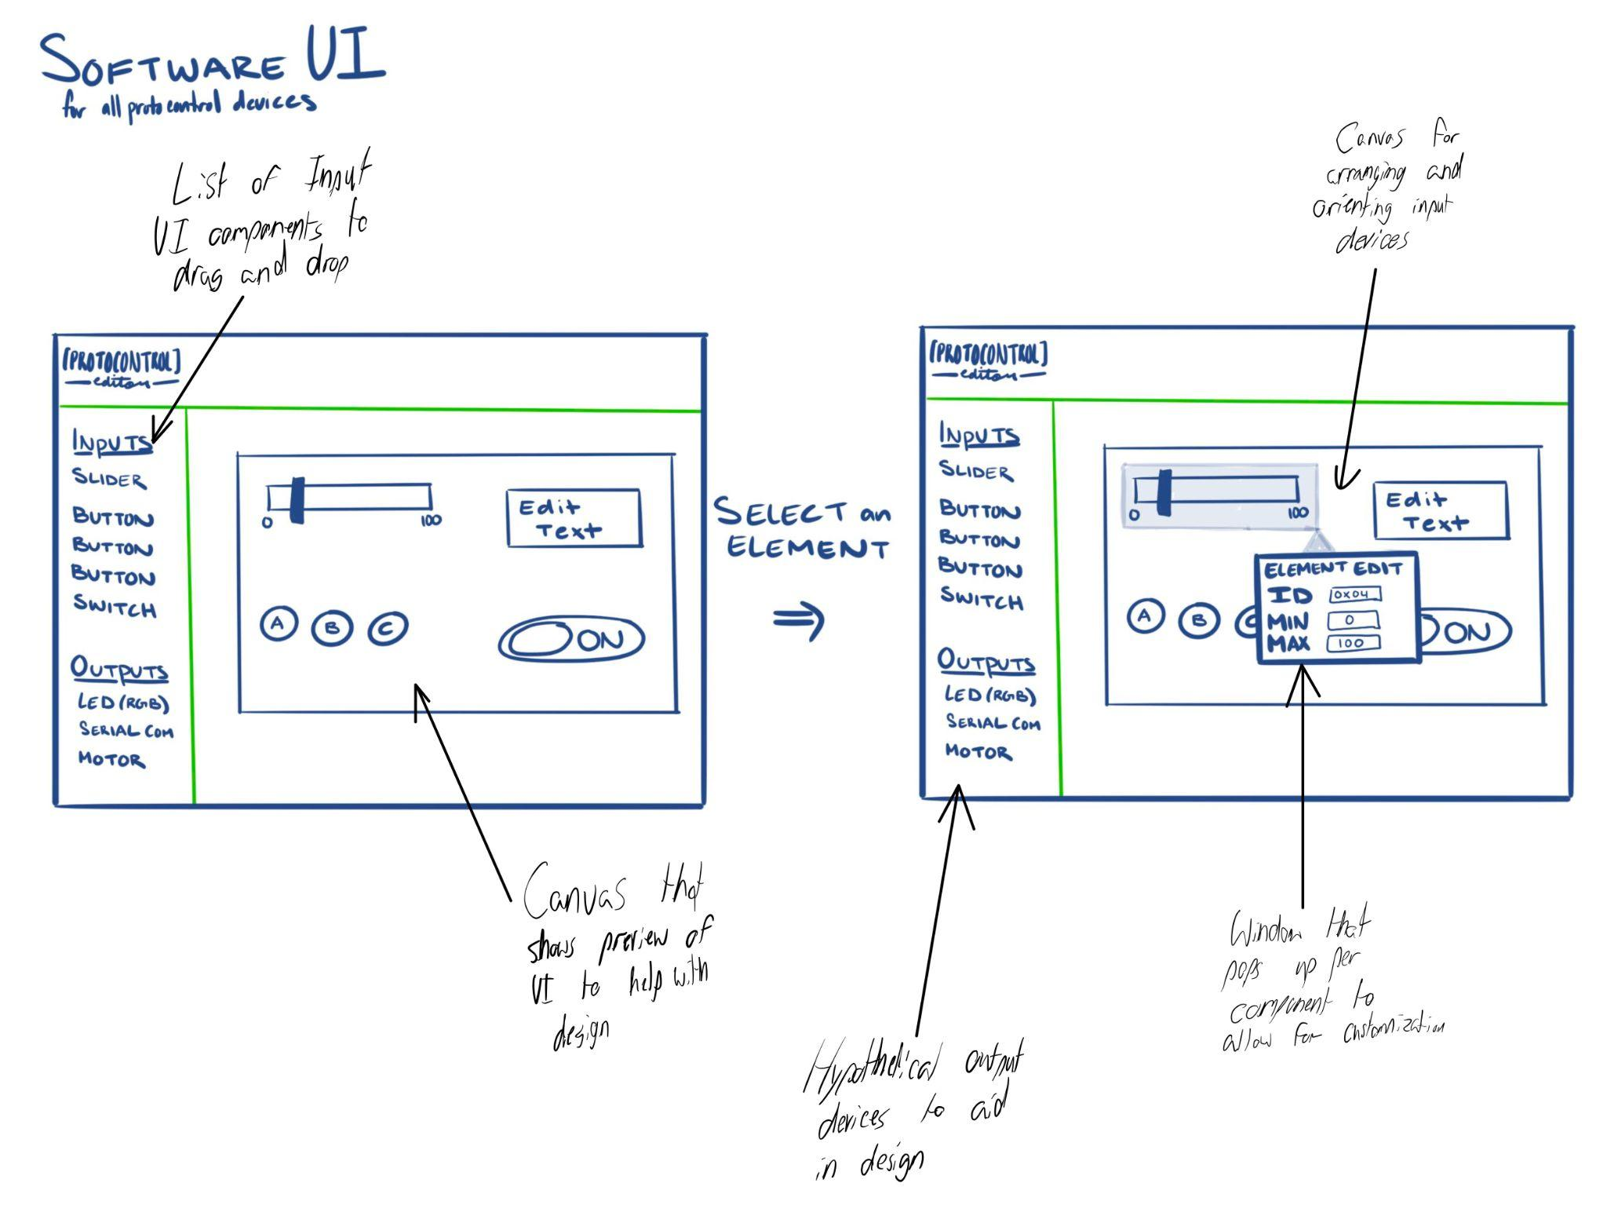
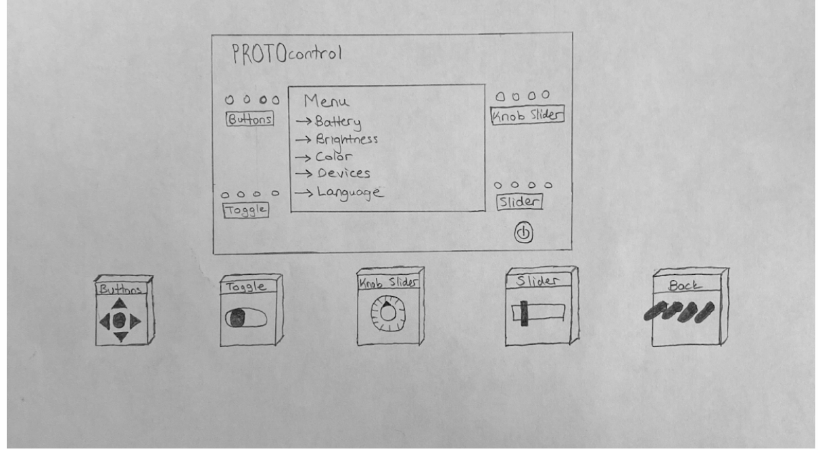
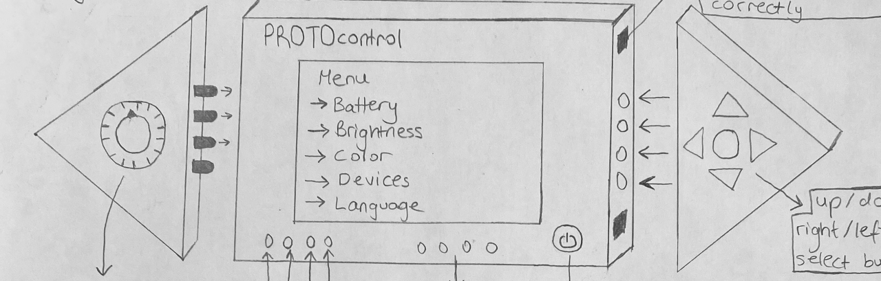
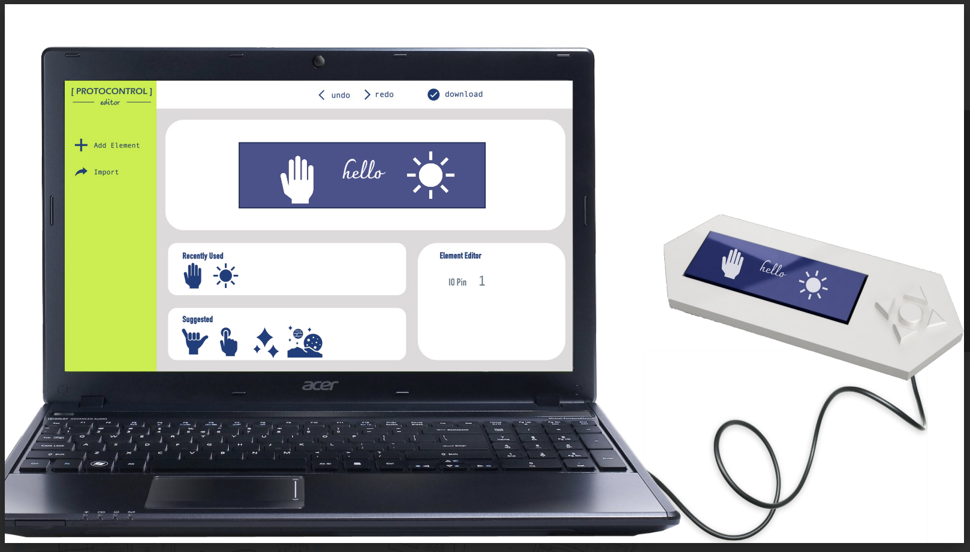
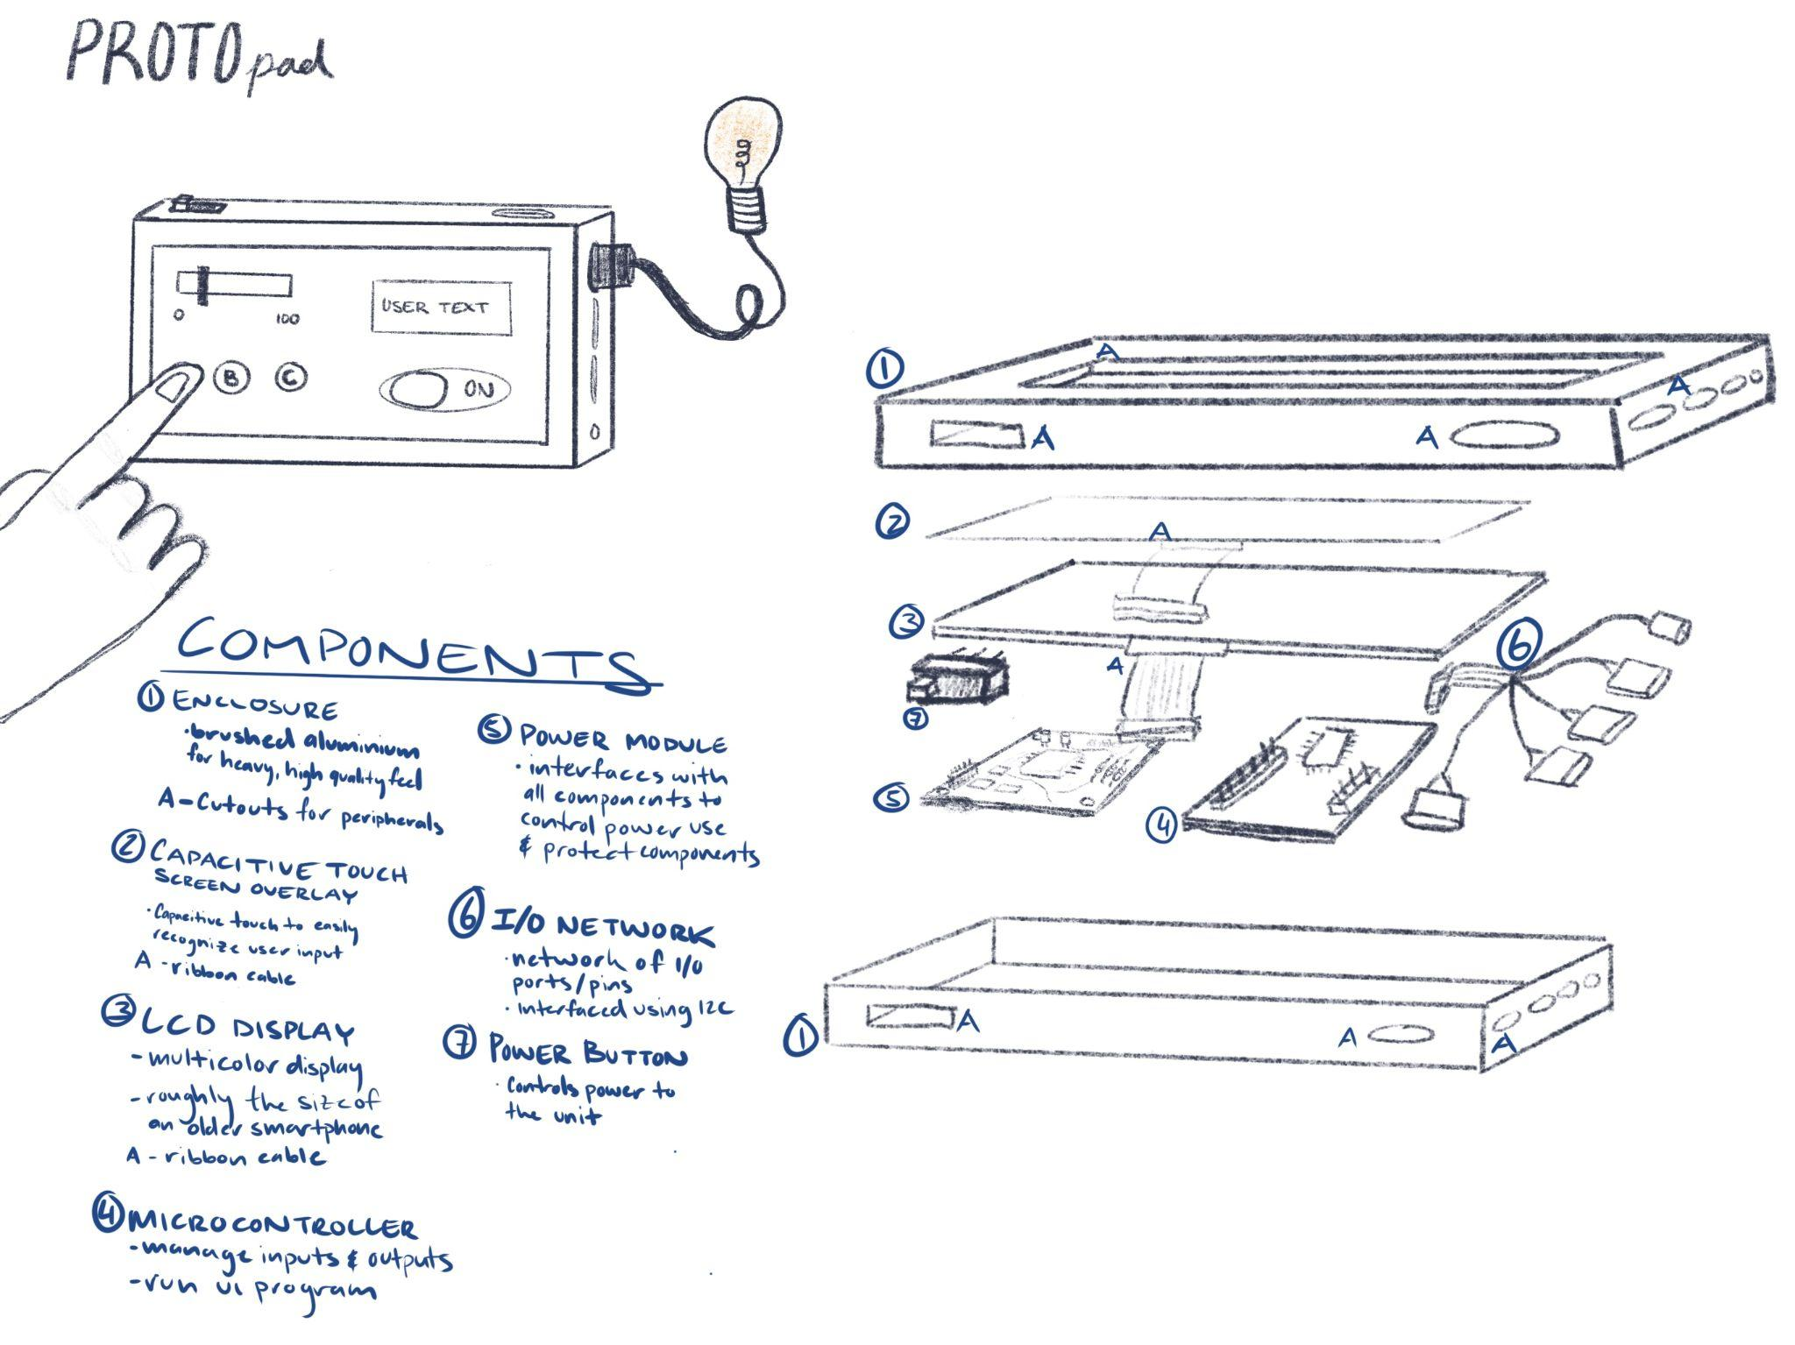
System Concept Drawing
Notes:
We are currently pursuing two pathways to solve the same problem. We have protopad which uses a touchscreen as the primary user interface and we have protokit where the UI is constructed of hardware components (buttons, toggles, sliders). This gives our clients the flexibility to create a solution that makes the most sense for their system.

Slide 7
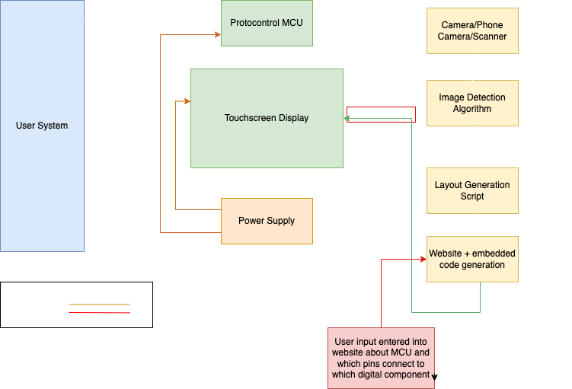
System Functional Block Diagram
Notes:
Keep updating this, fastest way to get someone up to speed with the project

Slide 8
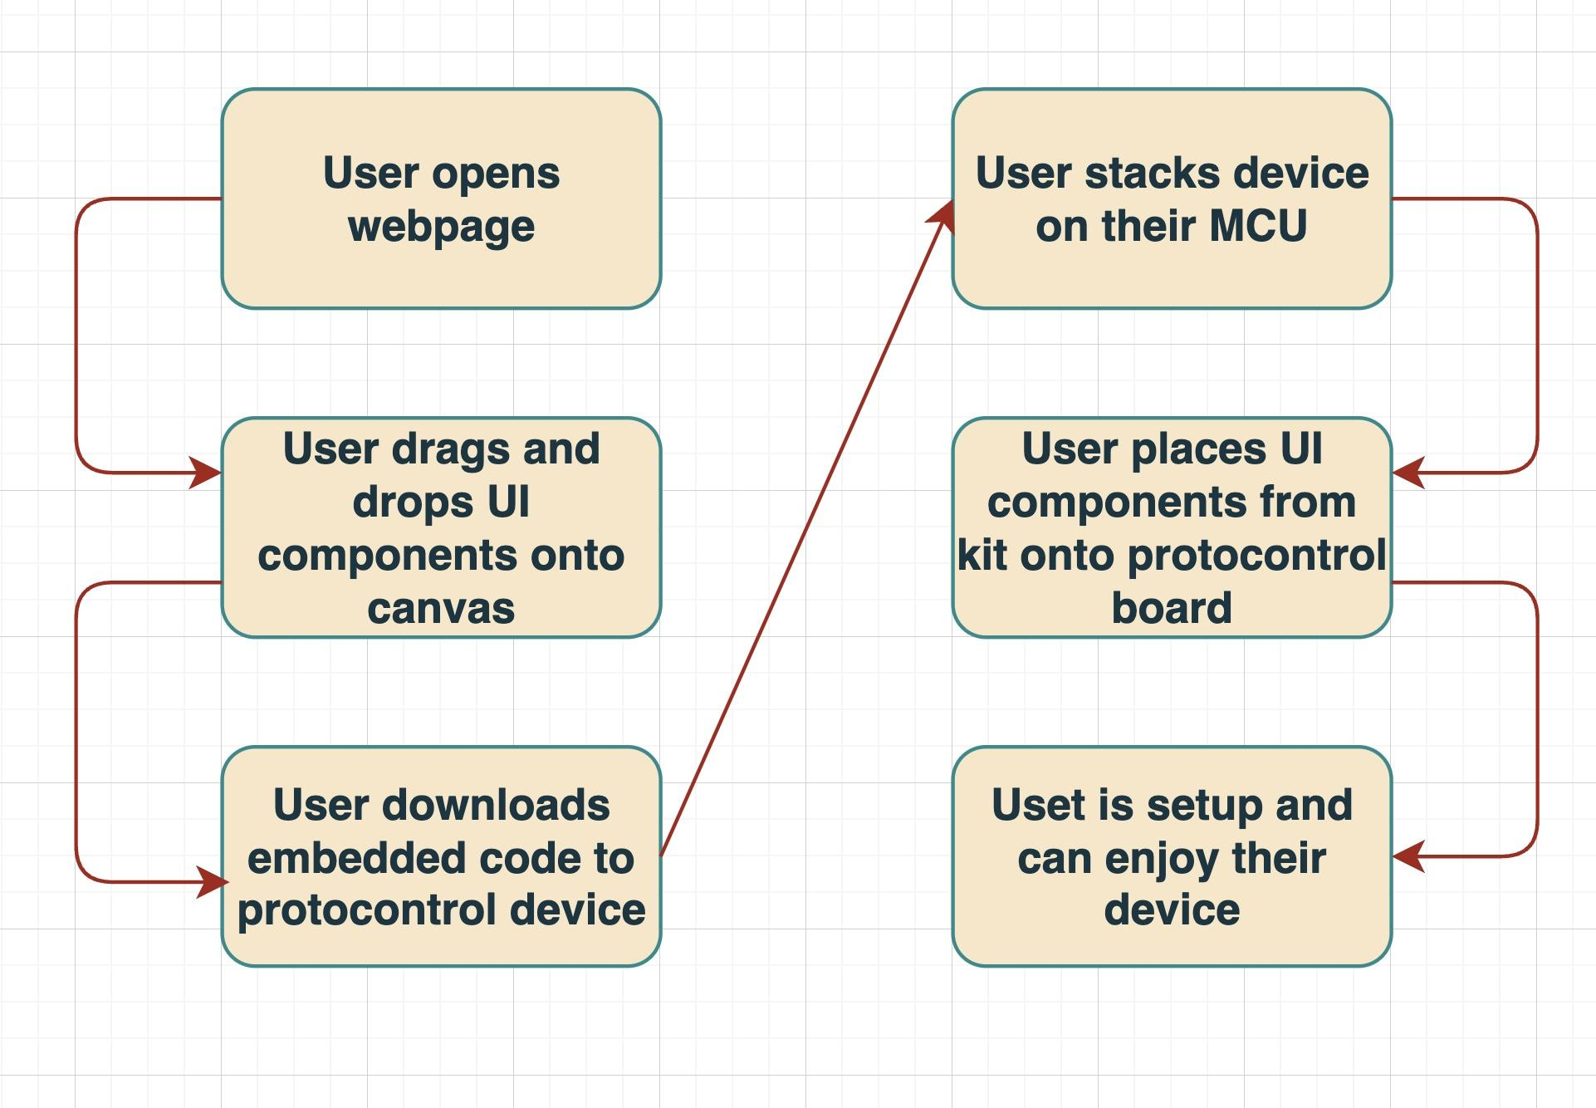
User Flow Chart
Notes:
Does anything about the user flow charts from the System Architecture Diagrams need to change?

Slide 9
Software

Slide 10






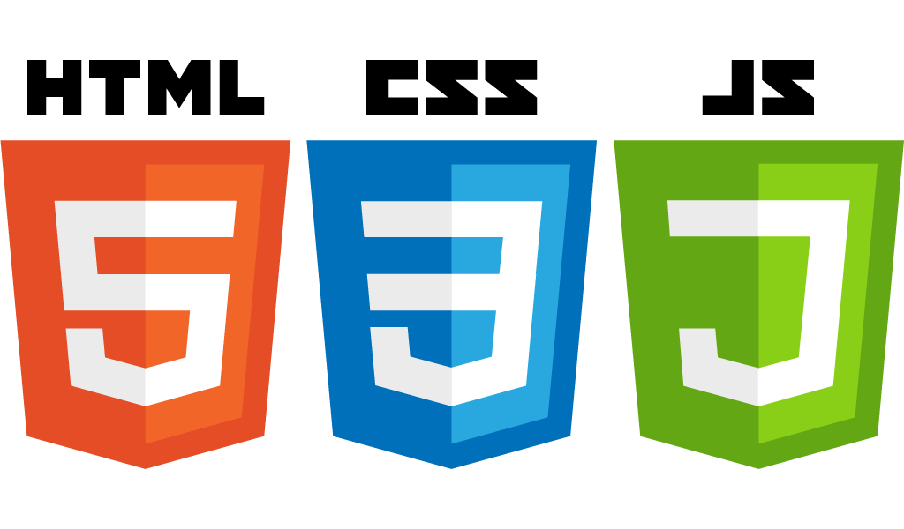

Subsystem - Software
ProtoControl Software
Website
Artificial Intelligence/ Cloud Services
Embedded Code Generation
Notes:
Don’t explain choices in services, save the explanation/justification for branch slides/tradeoffs
Emphasize use case of image processsing… introduce here, elaborate later

Slide 11
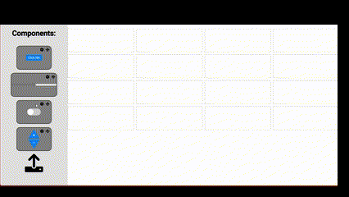
Website - Software Subsystem
Component-level HTML, CSS, and TypeScript code for increased modularity and abstraction
Configuration
After your initial design, modify each component to meet specific needs
2
Drag-and-Drop
Quick and easy interface to build and customize user interfaces
TypeScript will be the main programming language for the front end UI of the website
1
3
Code Generation
Parameterized functions allow for ready-to-use embedded code to be generated and downloaded straight to your device
We will take advantage of the Angular framework and its component based structure to aid in front end design
Notes:
Roughly 30 secon

Slide 12
AI/Cloud Computing - Software Subsystem
{
AWS Hosted
AWS instances will be used to host environments for image processing and analysis
{
API Calls
Startup
Health Check
Back to Front End
Docker will be used within AWS instances to normalize
Current Status
RESTful API
Website Front End
Python will be used for image processing and API endpoint definitions (OpenCV, Flask)
Input Image
YOLOv5 Algorithm

Slide 13
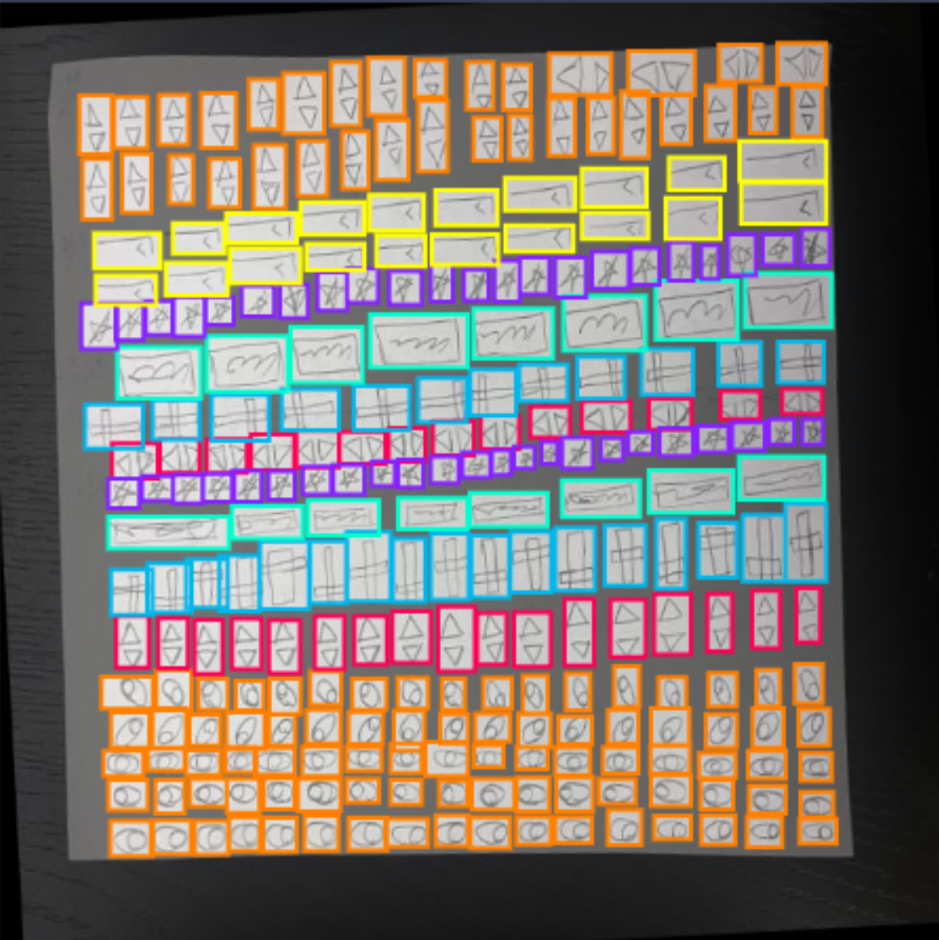
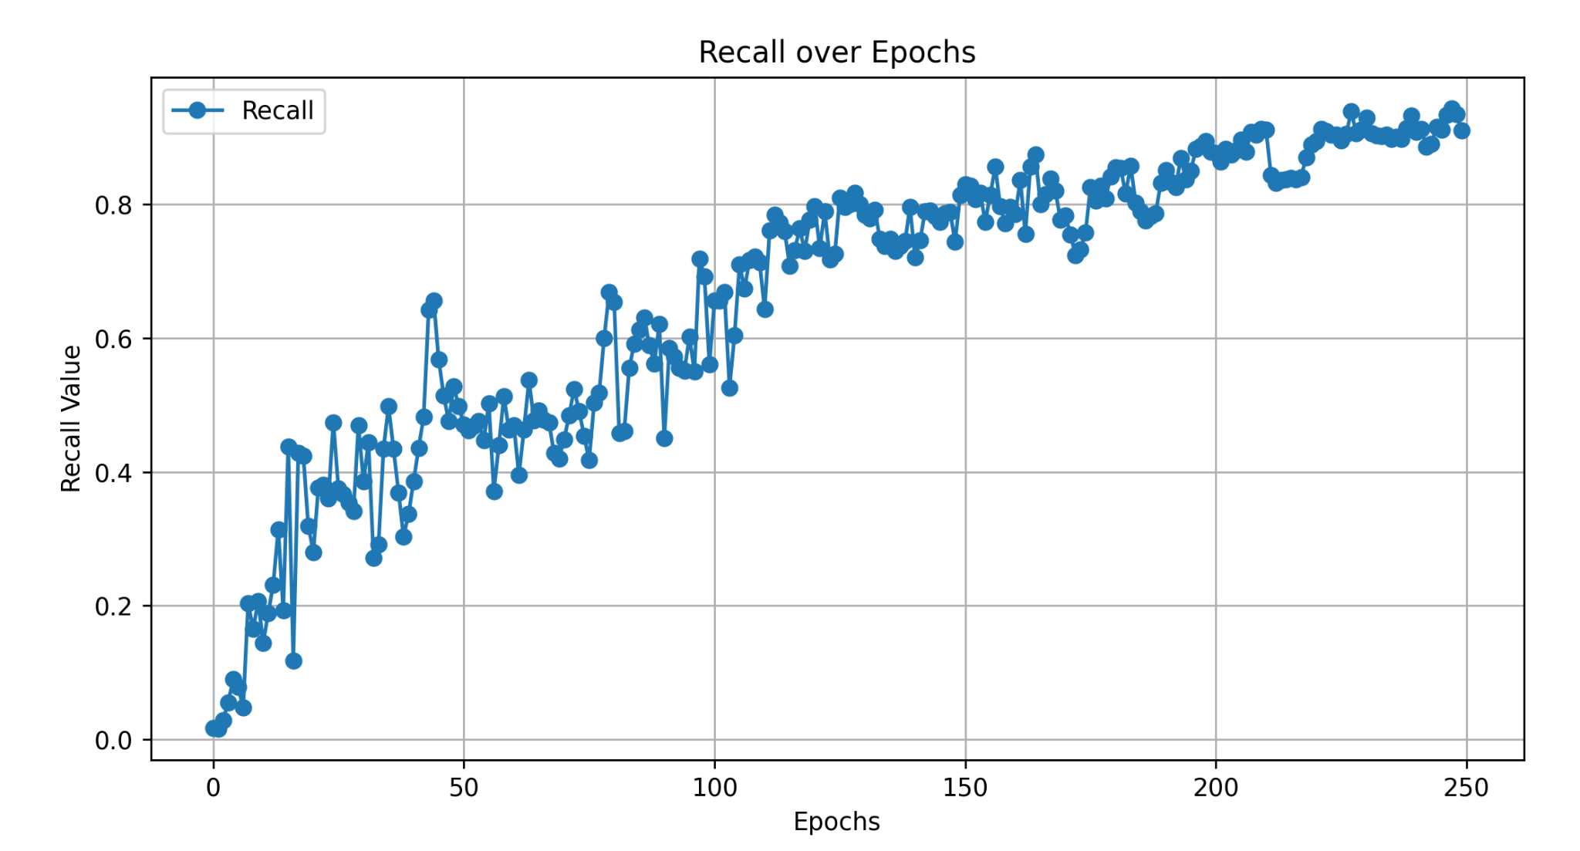
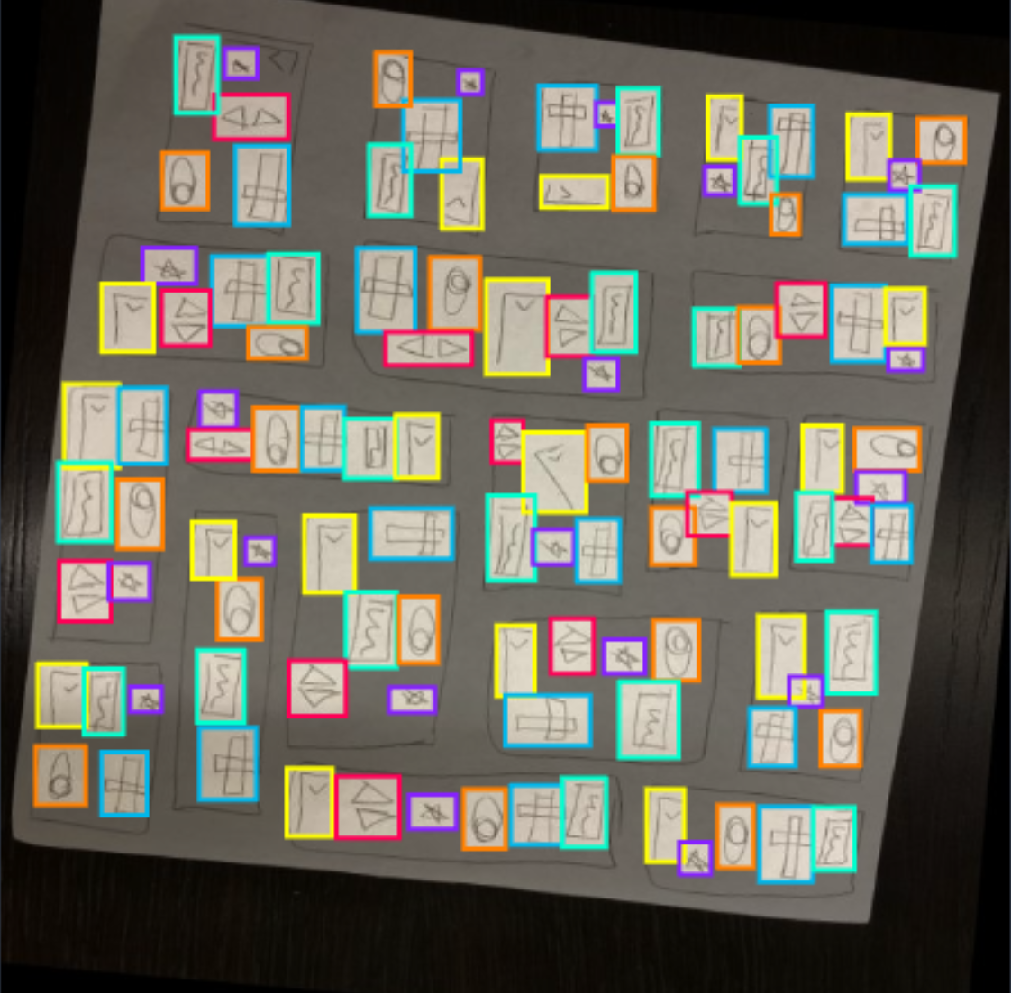
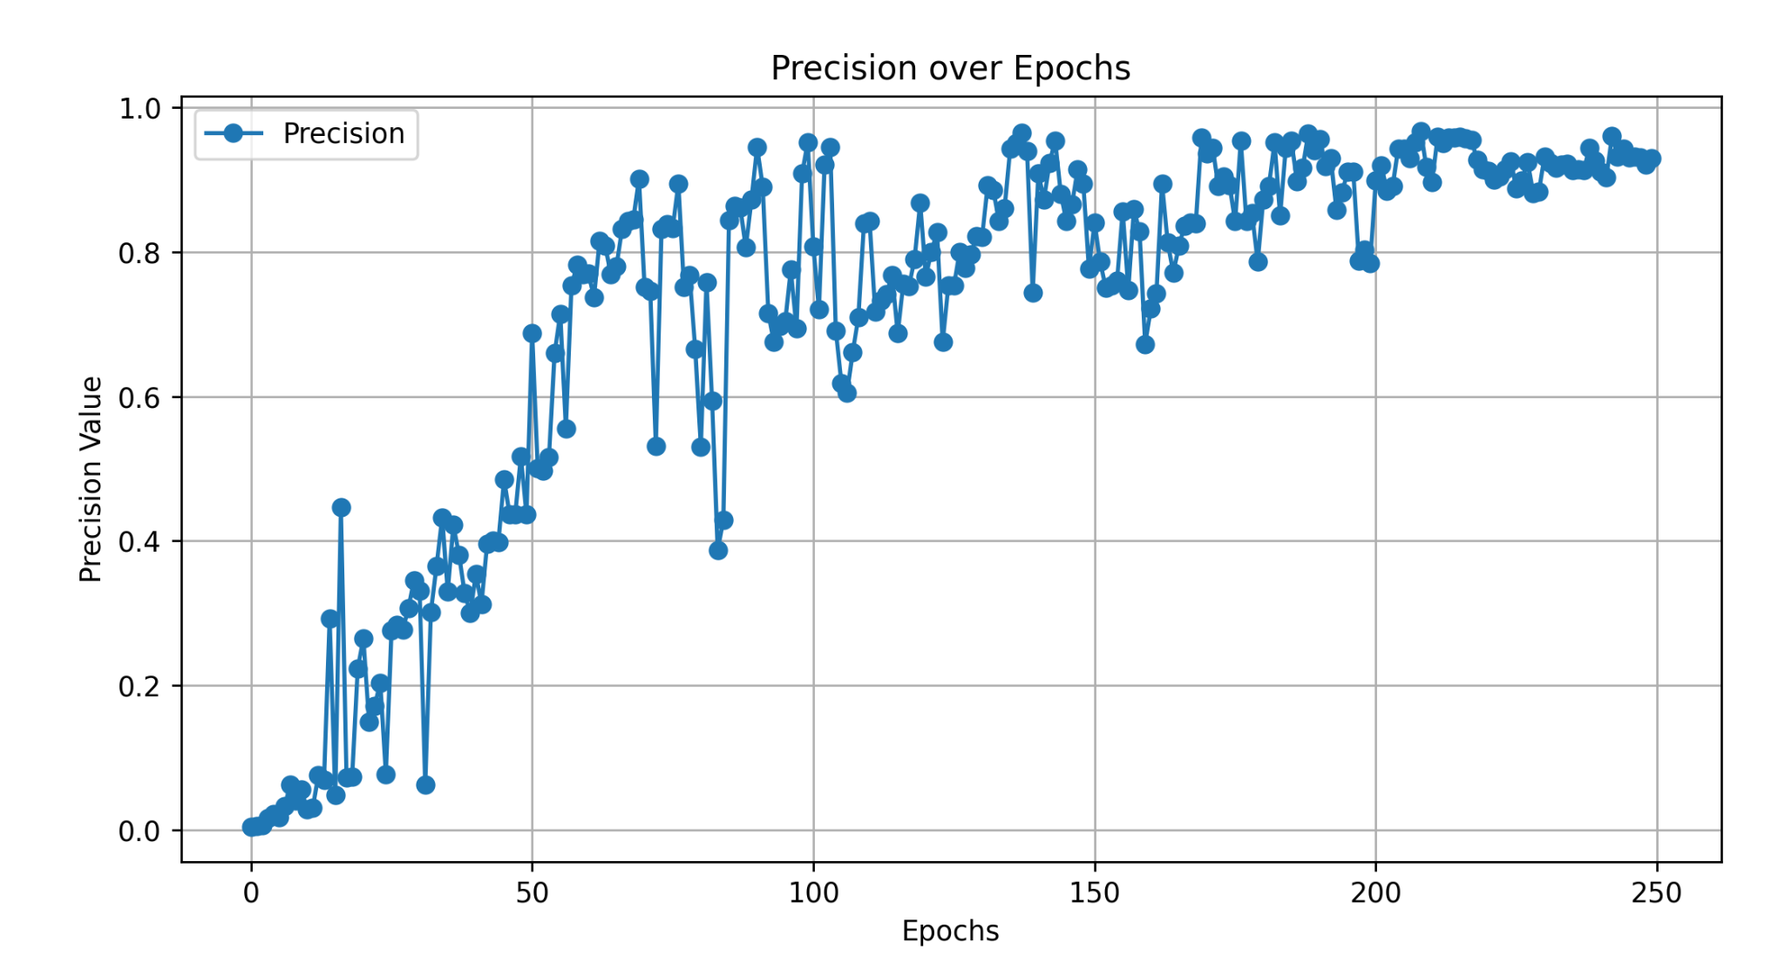
YOLOv5 Algorithm
Recall is defined as the number of true positives divided by the total number of objects in the image
Precision is the ratio of positive identifications to all identifications

Slide 14
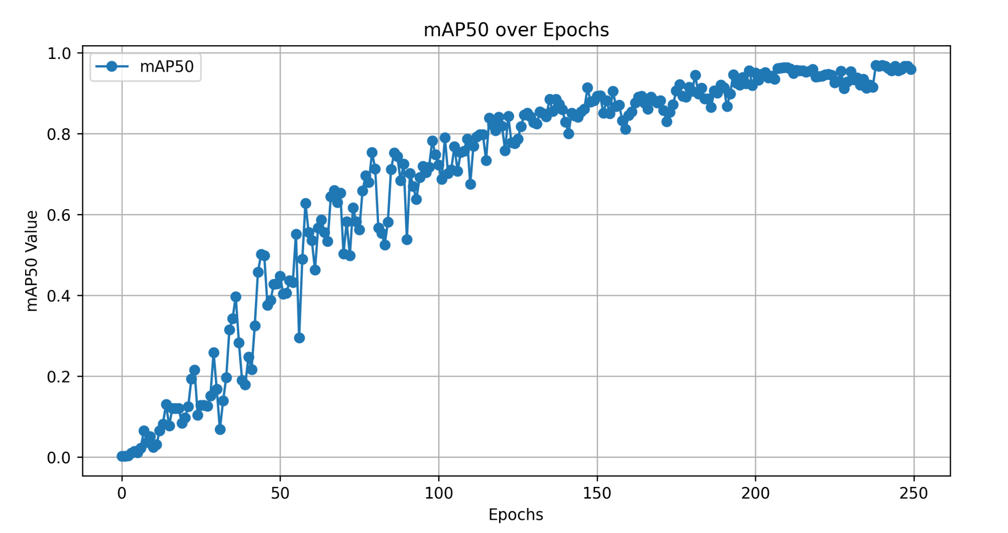

Slide 15
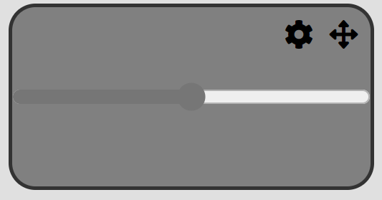
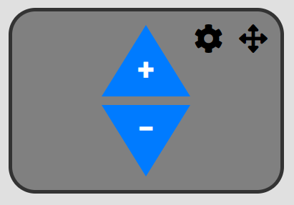
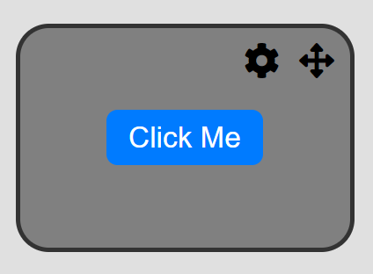
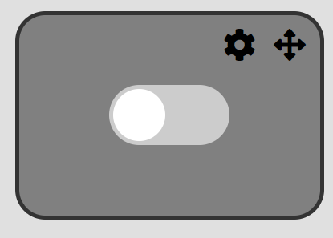
Embedded Code Generation - Software Subsystem
Most of the embedded code will consist of templated functions. The purpose of the websites front end is to extract the values needed to fill out the templates.
User Interface Components
Analog
Digital
Y-position
Width
Height
X-position
Minimum Value
Maximum Value
Slider
Increment/Decrement
Button
Toggle
Embedded code will be written in C or C++ (see footnote)
Arduino IDE will be used to compile and download code (see footnote)
Disclaimer: Specifics regarding programming languages/IDE’s are subject to change as the development process continues

Slide 16


Software Trade-Offs TO-DO
Less dependent on libraries
Feature
Chosen Option
Rejected Option
Benefits Over Alternatives
Cons
1
Front End Web Design Framework
Angular
React
Ahead-of-time compilation
Previous experience with Angular
Less dependent on libraries
Less community support
Potentially longer build times
Third party integration difficulties
2
Cloud Hosting Service
Amazon
Microsoft
Greater service offering
Greater community support
More familiarity with AWS
Lacks hybrid hosting options
Poorer integration with Microsoft
3
Multiple Object Detection Algorithm
You Only Look Once (YOLOv5)
Single Shot Detection (SSD)
Faster runtimes
Faster training times
Previous experience with YOLO
Generally less accurate
Better detects overlapping objects
Less accurate with smaller objects
4
UI Design Method
Drag and Drop
Click and Place
Low opacity preview of components in place
More intuitive
More difficult to implement
Requires more user interactions

Slide 17
Embedded Software

Slide 18
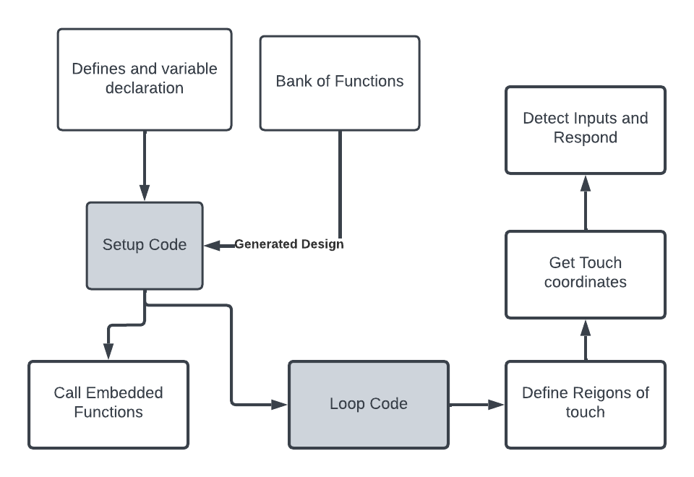

Embedded System Block Diagram

Slide 19
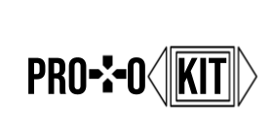
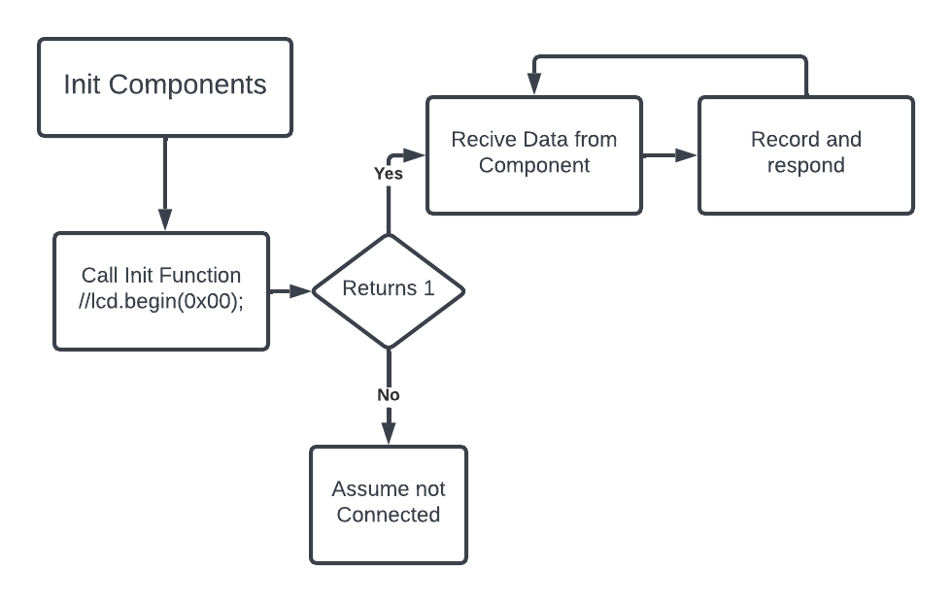
ProtoKit Hardware detection

Slide 20
Challenge - Drawing a button with one function
Using tft HX8340B And Adafruit_GFX
drawButton(x,y,Height,Width,text,color);
Y
Press
X
Height
Width

Slide 21
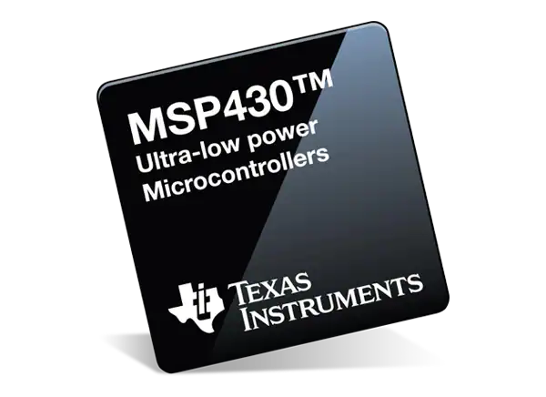

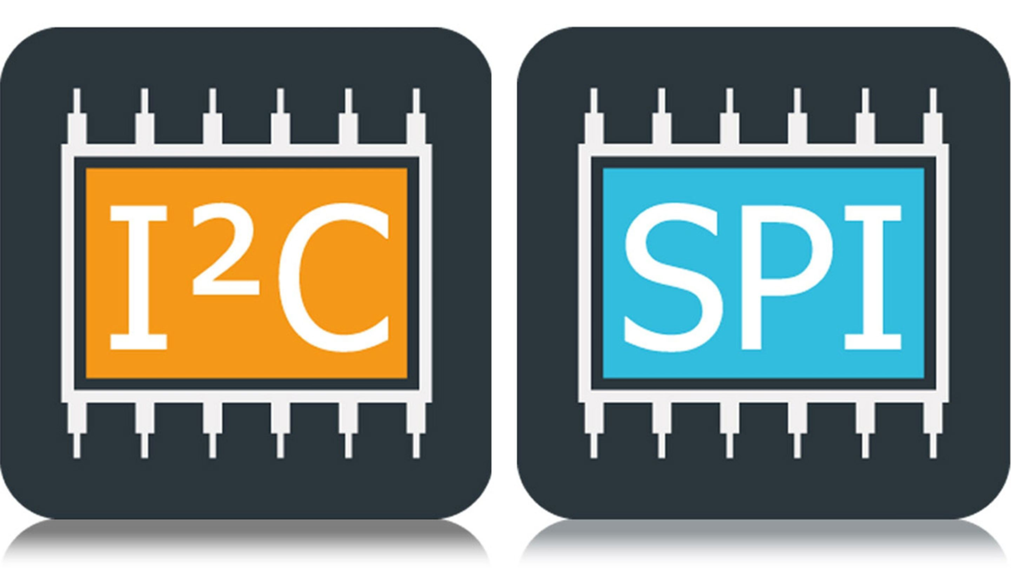
Trade Offs
MCU:
Ease of use
Standard form factor
Selected: Arduino
Serial protocol:
Address - bus system
Universability
Selected: I2C
Notes:
recenter

Slide 22
Serial Communication IC and Physical Connection

Slide 23
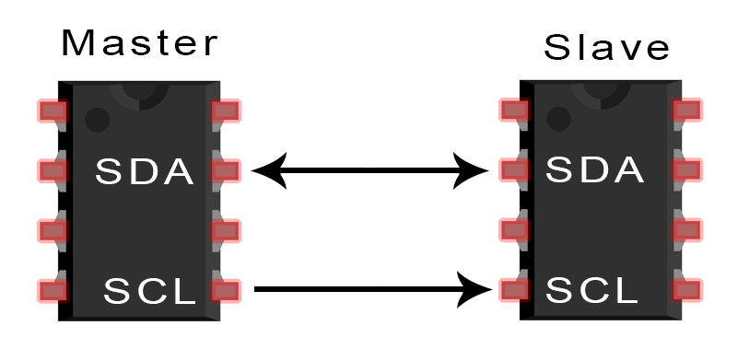
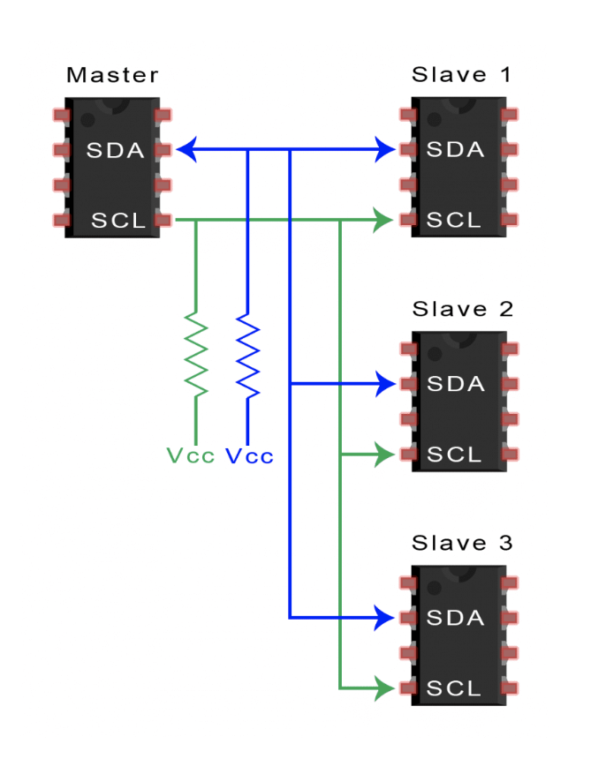
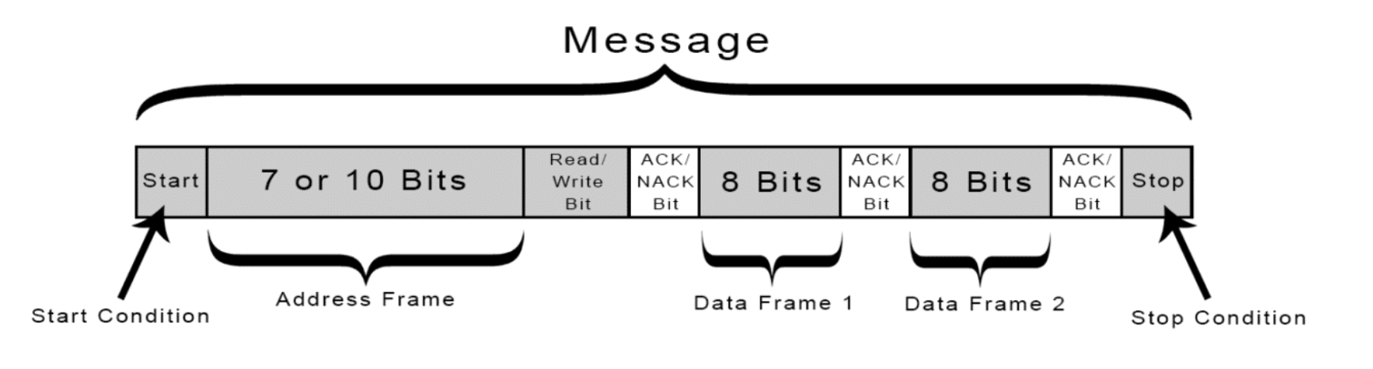
I2C Communication Protocol
Notes:
Sources + Image Credits
https://www.circuitbasics.com/basics-of-the-i2c-communication-protocol/
https://www.analog.com/en/technical-articles/i2c-primer-what-is-i2c-part-1.html
https://www.ti.com/lit/an/slva704/slva704.pdf?ts=1696235712185&ref_url=https%253A%252F%252Fwww.google.com%252F
https://www.geeksforgeeks.org/i2c-communication-protocol/
https://www.seeedstudio.com/blog/2022/09/02/i2c-communication-protocol-and-how-it-works/
Salient Points
Like SPI: synchronous; can connect multiple masters to one slave or multiple slaves to one master
Useful when we have 2+ MCUs transmitting to a single memory card
Displaying text to a single LCD
Like UART: uses two wires to transmit data
SDA
SCL
Common ground
No Select Lines→Address Bits + comparator are responsible for control
Slave must send ACK bit to acknowledge receiving the address/Read-Write Bit
ACK bit must be sent by the receiver of the data
Multiple Masters and Slaves–Master must check if any of the SDA lines are currently high (meaning another Master has control)
Slave can never initiate a data transfer
I2C devices connect to the pin with open collector or open drain pins which pulls the line low
Pros of I2C
acknowledge/not acknowledge bits gives confirmation for each frame
128 unique addresses
Cons of I2C
Slower than SPI and requires more hardware
Size of the data frame is limited to 8 bits (Can you have more than 2 data frames?)
My Questions
Can you have more than 2 data frames? Is it always 1 ACK/NACK + 8 bits until we get a stop bit?

Slide 24
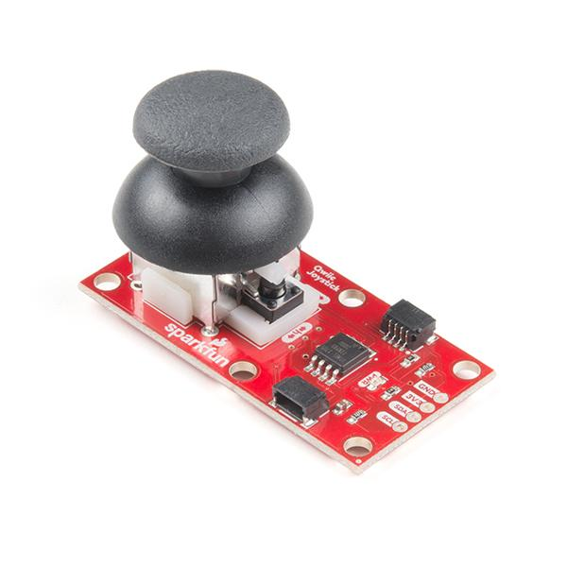
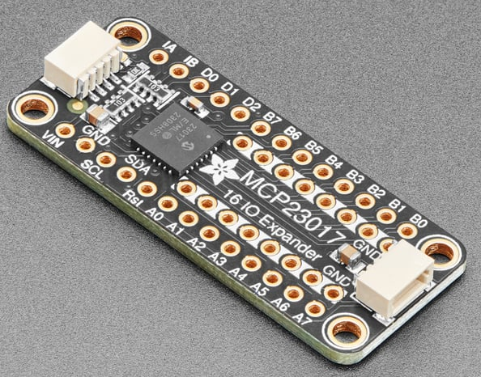
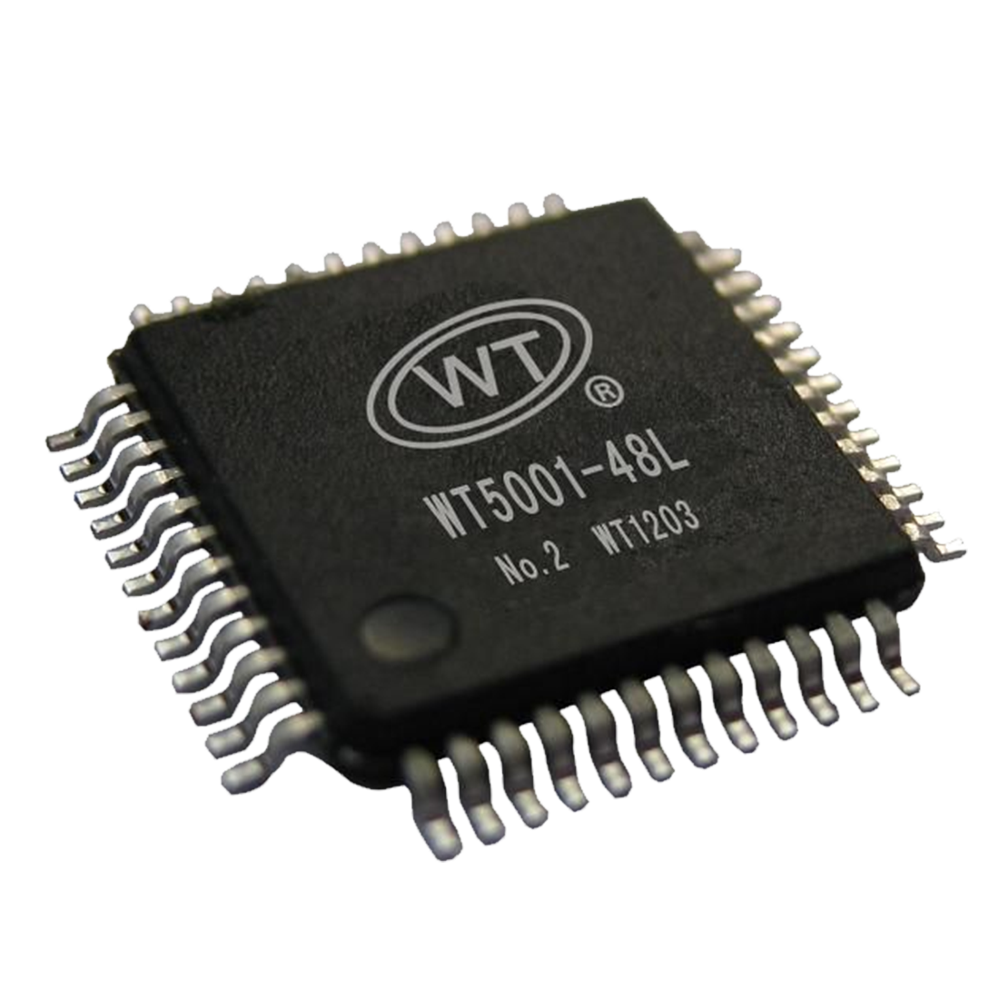
Converting Raw Data to I2C Format
 | Pros | Cons
I/O Components with built in I2C Board | -Well documented -Lower initial learning curve -Smaller lead times -Initially smaller | -2 parts with the same address cannot connect to same pin expander -cost of I/O components increases -May overwork each port
GPIO Pin Expander
Custom IC | Long term cost is lower More control over addressing IP/ability to sell Skill Development | -FPGA Dev Board is large -Initially more expensive -Time Consuming to make - Steep learning curve
Use off-the-shelf components as a placeholder while Custom Serial Conversion Chip is being developed
Notes:
Image Credits:
https://www.sparkfun.com/products/15168
https://www.adafruit.com/product/5346
https://www.cleanpng.com/png-microcontroller-integrated-circuit-electronics-cen-316140/download-png.html
The data coming from a user input (button, slider, joystick, rotary encoder) is not in I2C format. It doesn’t have address bits, it doesn’t wait for a response from other parts of the system, it doesn’t divide data into frames.
There are many ways we can solve this design challenge.
We can purchase I/O components that come with a Qwiic Connection System and are I2C compatible
We can use a GPIO Pin expander
Not for its advertised purpose (not for more pins)
But for its ability to convert data into I2C format
Custom IC
We can make sure we are not running each port too hard (more control)
Long term cost
IP and being able to sell in the future
Be in charge of defining addresses
In general we need a GPIO pin converter so that we can use inputs without a custom i2c board. We need to convert raw data into i2c format and back

Slide 25
Design Challenges
Understanding the I2C sequence of events
Use I2C documentation as a foundation for timing diagrams
Finalizing Top Level Pins
Use existing datasheets as a foundation for necessary subsystems
Components must “handshake” with other subsystems
Incorporating an iterative process
Optimizing performance (timing, size, power consumption) to be industry competitive
Use Synopsys for timing optimization
Translate, Map, Place & Route (Convert Design to FPGA)
Synthesis + Functional Verification
Static Timing Analysis + Back Annotation
Behavioral Modeling (Verilog) + choose FPGA
In Circuit Verification

Slide 26
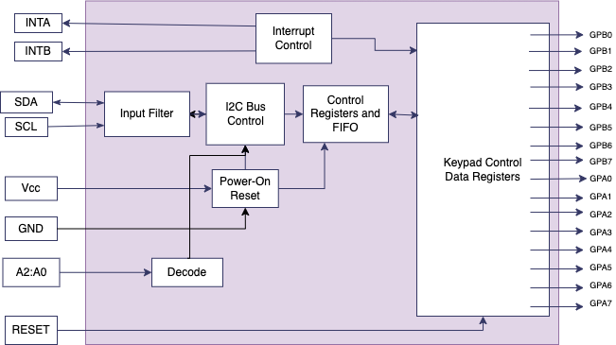
Top Level Block Diagram of GPIO Pin Expander
Pin Legend
GPB0:GPB7 ~ GPIO Ports
GPA0:GPA7 ~ GPIO Ports
INTA ~ Interrupt Output
INTB ~ Interrupt Output
SDA ~ Serial Data Bus
SCL ~ Serial Clock Bus
Vcc ~ Supply Voltage
GND ~ ground
A2:A0 ~ Address input
RESET ~ Active Low Reset
Notes:
Sources + Image Credit:
https://learn.adafruit.com/adafruit-mcp23017-i2c-gpio-expander/pinouts (MCP23017T-E/ML)
https://www.mouser.com/datasheet/2/268/MCP23017_Data_Sheet_DS20001952-2998473.pdf
https://www.ti.com/lit/ds/symlink/tca6418e.pdf?ts=1696144660244&ref_url=https%253A%252F%252Fwww.google.com%252F
https://www.nxp.com/docs/en/brochure/75016987.pdf
https://core.ac.uk/download/pdf/153212341.pdf
https://www.electronicsforu.com/electronics-projects/software-projects-ideas/designing-fpgas-i2c-master-controller-part-1-5
https://www.mouser.com/datasheet/2/302/PCA9536-3139488.pdf
https://www.mouser.com/datasheet/2/609/MAX7314-3130440.pdf
https://semtech.my.salesforce.com/sfc/p/#E0000000JelG/a/44000000MDfm/vZ5YFK5eAWFpBLDKRgs6n2TDV.SiPQCWjJOo7I1BCGc
TI, ADI/Maxim, NXP, SEMTECH, Fairchild, Microchip
Differences among block diagrams
TIs seems the most straightforward
Hardware address pins to identify output devices

Slide 27
Trade-Offs for FPGA Development Boards
 | Cost | IDE | Clock tiles | Gates | Block RAM | Special Features
Basys 3 Artix-7 FPGA Trainer Board: | $165.00 | Vivado | 5 | 90 DSP slices; 33,280 logic cells in 5200 slices | 1800 Kbits | USB-uart port
Nexys A7-100T Artix 7 FPGA XC7A100T | $350.00 | Xilinx Vivado, Xilinx ISE | 6 | 240 DSP slices; 15,850 logic slices | 4860 Kbits | LEDs, Switches, Temperature Sensors, MicroSD slot, USB-uart port
Micromod Alorium Sno M2 Processor Board | $52.50 | Arduino IDE | X | 16000 | X | -Xcelerator Block Library - M.2 connector - works with AT mega328
Notes:
Additional Information
Micromod Alorium Sno M2 Processor Board
Vendor: Sparkfun
Xcelerator Block Libraries: Servo Control, Quadrature, Floating Point Math, NeoPixel, Enhanced Analog-to-Digital Converter
Nexys A7-100T Artix 7 FPGA XC7A100T Artix™ 7 FPGA Evaluation Board
Available in makerspace
Available on Digikey
https://digilent.com/shop/nexys-a7-fpga-trainer-board-recommended-for-ece-curriculum/
Basys 3 Artix-7 FPGA Trainer Board:
Available on digikey
https://digilent.com/shop/basys-3-artix-7-fpga-trainer-board-recommended-for-introductory-users/

Slide 28
Trade-Offs for GPIO Pin Expanders
 | Cost | Compatibility | I/O Count | Power Req | Vendor | Frequency | Spec | Size
MAX7314 | $6.59 | Must be soldered into PCB | 18 Port GPIO | 2-3.6 V operation | Analog Devices | X | 400kbps | 4mm x 4mm (does not have breakout board)
TCA6418E | $1.22 | Must be soldered into PCB | 18 GPIO pins | 1.65-3.6 V operation | Texas Instruments | 1 MHz max | X | 2 mm × 2 mm; 0.4 mm pitch
MCP23017 I2C GPIO Expander Breakout | $5.95 | Has STEMMA QT connectors, Arduino compatible | 16 GPIO pins | 3-5 V operation | Adafruit | X | X | 43.0mm x 18.0mm x 5.0mm
Notes:
Three GPIO Pin Expanders
https://www.adafruit.com/product/5346?gclid=CjwKCAjw9-6oBhBaEiwAHv1QvIouJK2dAWjTSeaFB_3pKvtWkjtS-o8dAbkodCFtNZY735qyBXyTZBoCHXYQAvD_BwE
https://www.ti.com/lit/ds/symlink/tca6418e.pdf?ts=1696144660244&ref_url=https%253A%252F%252Fwww.google.com%252F
https://www.mouser.com/datasheet/2/609/MAX7314-3130440.pdf

Slide 29
Subtasks
Iterative Process + Parallel Workflow
Timing Diagram for I2C
Learning Technology
Verilog Script that Mimics I2C
Research
Learn Vivado
Verilog Script (binary inputs to I2C)
Verilog Script (analog/data inputs to I2C)
Synthesis & Timing Optimization
Read datasheets for I/O components with I2C board
Gain familiarity with existing I2C chips

Slide 30
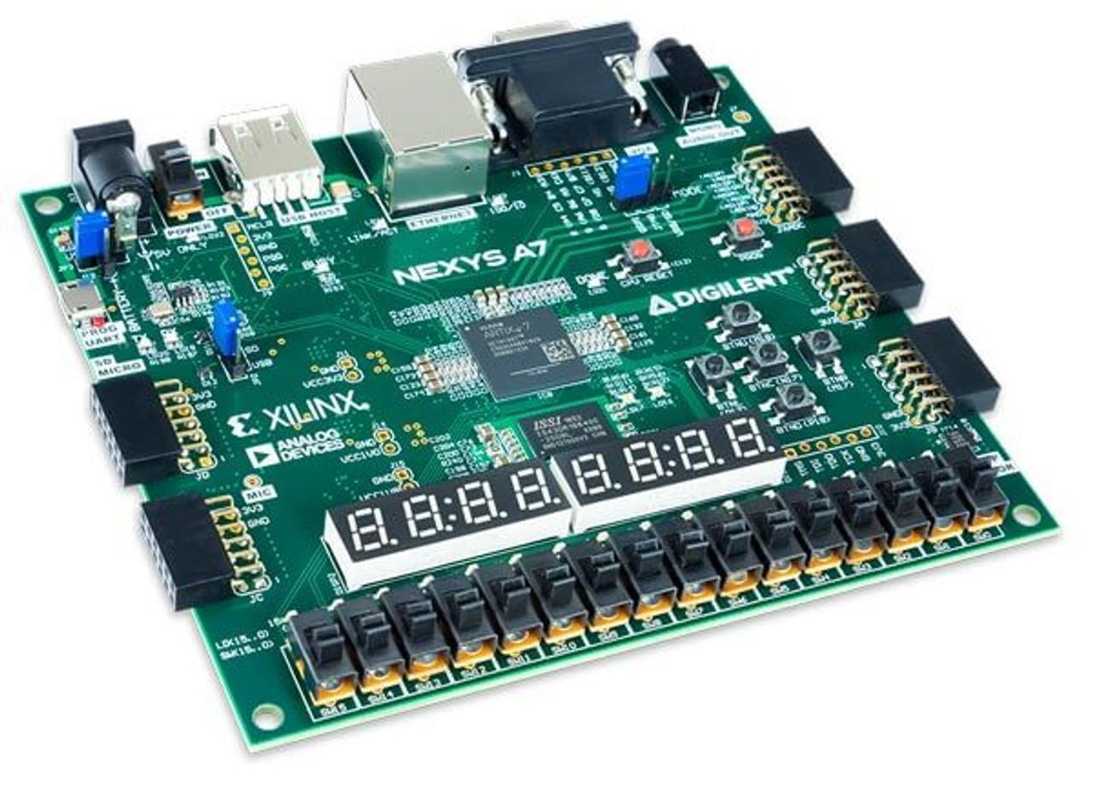
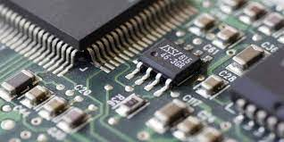
Serial Communication Mock Up
Short Term
Long Term
Notes:
In the short term (by the end of first semester) serial communication will be achieved through an FPGA development board but in the long term will be consolidated into a integrated circuit.

Slide 31
Custom PCB Design

Slide 32
Components / Parts
Arduino
Touch Screen (Resistive/Capacitive)
Rotary Encoder
Slider & possible other I2C components
GPIO Expander or a serial communication converter
Notes:
Capacitive if we get parts, hoping to have capacitive by hall of fame because it provides a more user-friendly experience

Slide 33
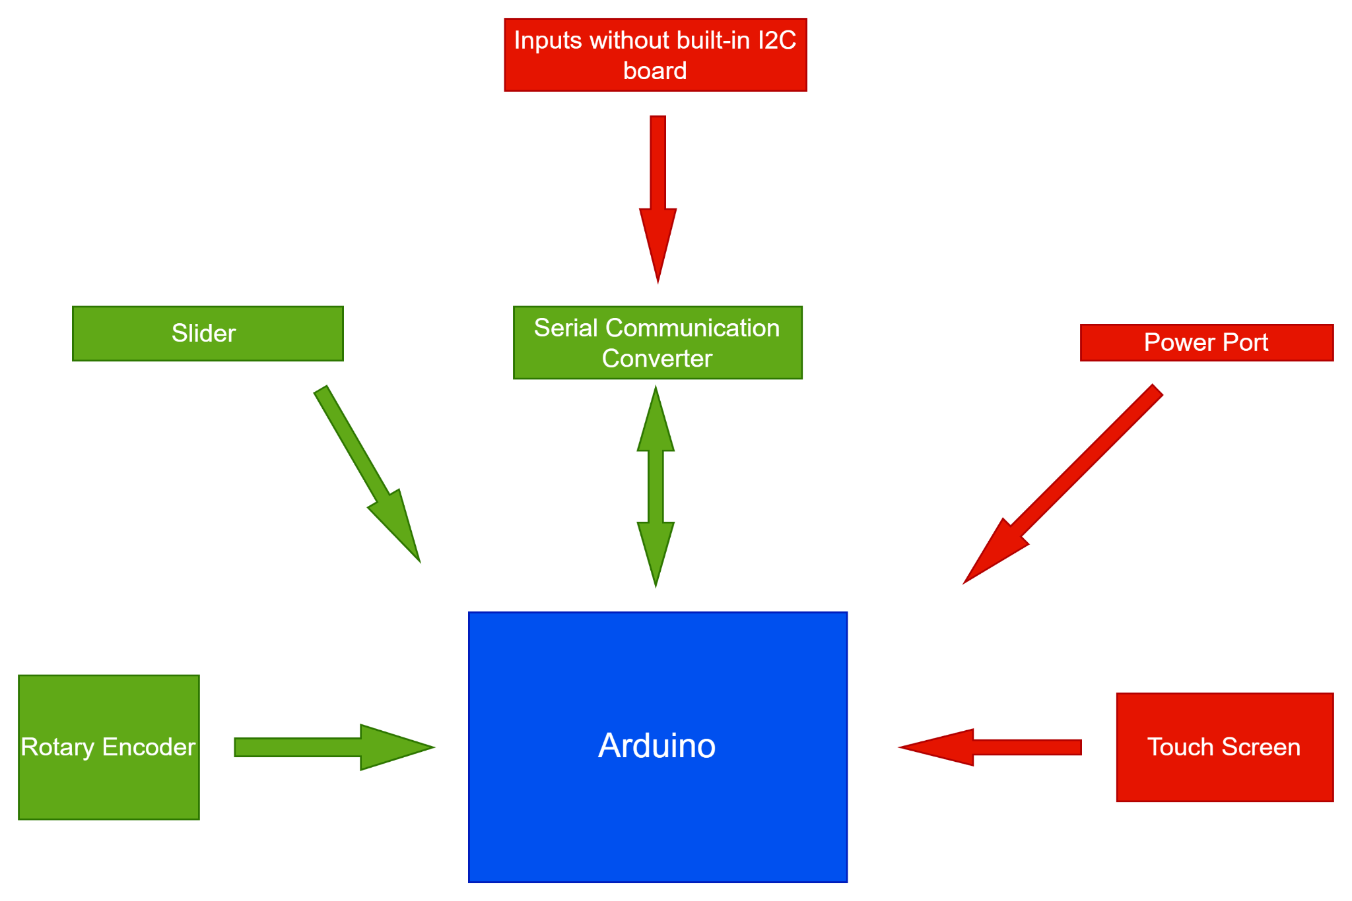
Custom PCB Design Block Diagram
Notes:
Add type of data transferred by the arrows and units

Slide 34
Design Challenges & Plans to Overcome Challenges
Challenge: Power Consumption
High power consumption can lead to overheating, shortened life-span of components and electromagnetic interference.
Challenge: Size of the PCB
An ideal sized PCB should include all the necessary components without creating electromagnetic interference.
Challenge: Switching to Capacitive Touch Screen
Changing the resistive touch screen we have at this point to a capacitive one will require some changes in the design of the PCB.
Challenge: Thermal Performance
PCB overheating can cause disruption in the integrity of the circuit affecting the system performance
Solution: Picking low-power components, implementing sleep-mode, using low-power design techniques
Solution: Finalizing the list of necessary components, simulating signal routing using EDA tools and making sure we leave room for any additional components we might want to add later
Solution: Understanding capacitive sensing more in depth and build an alternative circuit to work with the capacitive touch screen
Solution: Planning pad thickness appropriately, placing high-power components in the center of the PCB.
Notes:
Low-power design techniques: reducing MCU operating voltage, using larger resistors, pulling power from the power port not from the arduino
New circuit to work with capacitive touch screen is likely to consume less power which will affect other components
Pad thickness: dissipate heat, place high power components like controllers and microprocessors in the center

Slide 35




EDA Tools
Our expectation from a good PCB design tool is to meet industry standards, be user-friendly and offer free educational license. We also want to have a circuit simulator available to us in the software, therefore we narrowed our options down to the following four:
Notes:
Reasons why we need EDA tools, what are industry standards?,

Slide 36
Trade-off Table
EDA Tool
Advantages
Disadvantages
BOM generation system
3D modeling capabilities
Extensive component libraries
Auto-router is limited
Higher cost
Steeper learning curve
Built in 3D viewer
Unlimited (No extra versions)
One of the fastest PCB design tools
Not being able to create a new project from an existing one
Hard to manage libraries
Challenges with copying from one schematic to other
Advanced routing capabilities
Support for constraint driven design
Power integrity analysis tools
Not as user friendly as other options
Requires powerful hardware to run smoothly
Higher cost
No installation required
Easy to learn
Free
Not a good fit for complex designs
Requires internet connection
Not intended for industrial use

Slide 37
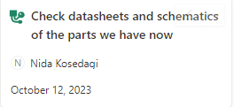
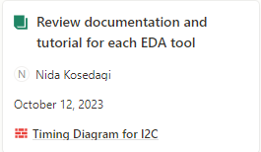
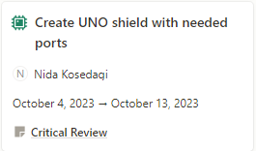
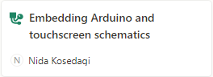
Subtasks

Slide 38
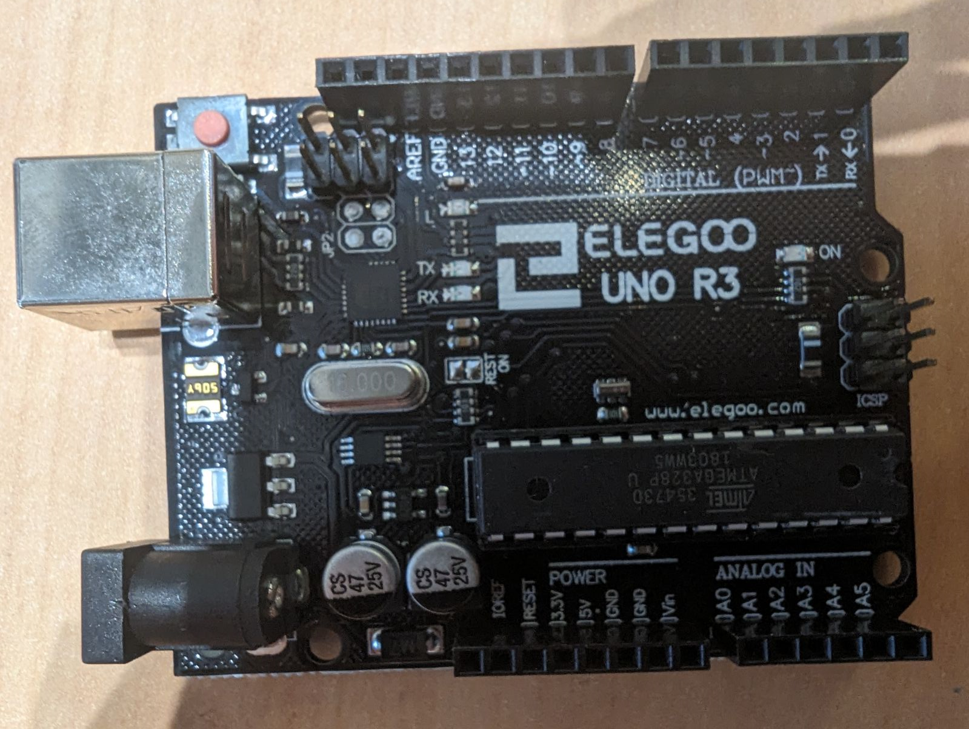
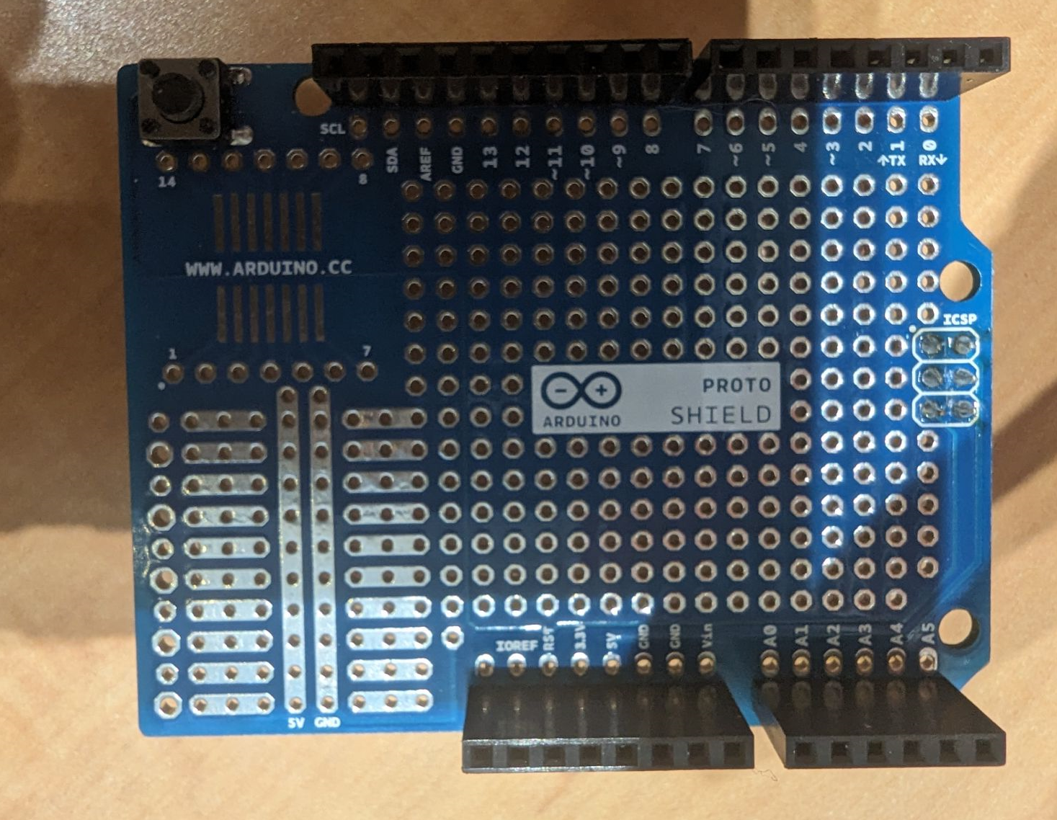
Mock Up
Arduino
Proto Shield

Slide 39
Enclosure and Power System

Slide 40
Design Challenges/Solutions
Challenges:
Power system
Inrush protection
Battery shall last 24 hours with continuous use
Battery charge controller shall be implemented
Enclosure
Passive cooling system
Shock resistant
Custom connector
How to Overcome:
Power system
System will be designed with a MOSFET to protect against inrush
Battery pack will be selected to meet requirements with respect to device form factor
System will be designed with a dedicated IC in the input circuit
Enclosure
Enclosure will be designed to direct heat out of enclosure
Enclosure will be designed to incorporate shock resistant materials
Utilize existing connectors as inspiration / direction with a focus on magnetic connectors
Notes:
Developing system based on constraints with a focus on areas we deemed as especially challenging given our background and current knowledge

Slide 41
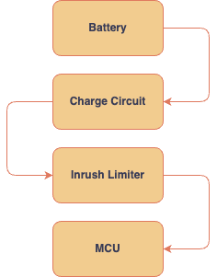
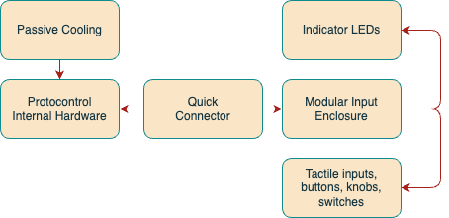
Functional Block Diagram
Power
Enclosure

Slide 42
Design Alternatives for subsystem and tradeoffs
Power System
Charge Controller | Dedicated IC - specific conversion - efficient - limited buck/boost support - needs heat management | Microcontroller - more expensive - flexible - more complex to implement
Inrush Protection | Yes - protects hardware - increases cost of unit - adds to power system size - might not be necessary due to lack of capacitors on device | No - less complex - cheaper - doesn’t regulate current
Battery | Swappable - extended life span of device - bulkier design - limits enclosure design - flexibility | Built-In - compact design - integrated charging - limited lifespan - hard to service - user friendly
Enclosure
Cooling | Passive - quiet - requires no additional power - more likely to allow components to overheat | Active - noisy - requires power - keeps components cool more consistently
Connector for Swappable Inputs | USB - very available and lots of documentation - inexpensive and easy to implement - can break due to depth | Custom Pin Head Based Connector - more expensive and time consuming to develop - adds custom feel to device - can reduce strain and be used many times before degradation
Material | Aluminium - sturdy and impact resistant - well made look and feel - expensive - more difficult to prototype | Plastic (PLA) - easily broken - cheap look and feel -inexpensive - easy to prototype
Notes:
From the design challenges, system constraints, and functional diagram the different aspects of both the power system and enclosure are shown here. After delving into each aspect, the design options highlighted have been selected

Slide 43
Components/Part Selection Tradeoffs
Power System
Dedicated IC Charge Controller Type | Dedicated IC - specific conversion - efficient - limited buck/boost support - needs heat management | Microcontroller - more expensive - flexible - more complex to implement
Inrush Protection Type | Thermistor - large voltage drop - generates significant heat from power loss - very simple - slow response | MOSFET - fast response - high efficiency - more complex - more expensive - minimal voltage drop
Built-In Battery Type | Lithium-Ion - HIgher energy density - well-developed technology - weight | Lithium-Polymer - flexible - lightweight - lower energy density - more expensive - safer
Enclosure
Passive Cooling Method | Heat Sink - effective heat dissipation - versatility - large size - heavy | Thermal Vias - space saving - low cost - design complexity - limited cooling capacity
Shock Resistant Material | Rubber - less expensive - better adhesion - high tensile strength - temperature sensitivity | Silicone - temperature resistant - consistently over lifespan - more expensive - less tear resistant
Notes:
For the selected design options, we learned about different options for each design choice and choose the options highlighted in blue based on the pros and cons when compared to other options. The next step is to take these choice and continue to learn about how to integrate them into the design

Slide 44
Guides and Tutorials
Goal: make PROTOControl as user-friendly as possible
Topics to cover:
Initial set up
How to upload a photograph
Designing a layout from scratch
Integrating with various MCUs
Flashing Code to the Display Panel and Components
Troubleshooting

Slide 45
Project Plan

Slide 46
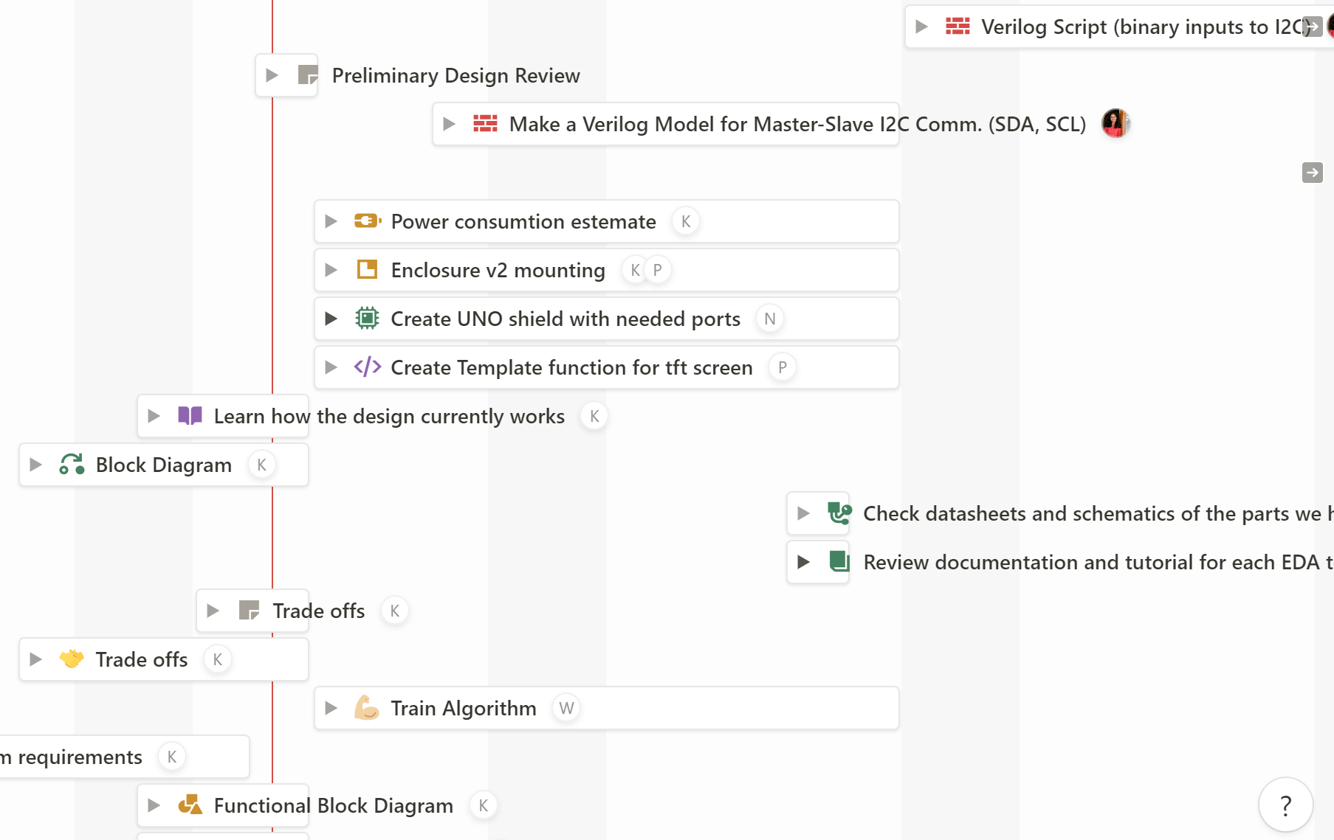
Project Timeline

Slide 47
Cost Estimate
Part | Price | Lab Part | Count | Notes
TFT LCD Touchscreen | $44 | Yes, for prototype only | 1 | Capacitive touchscreen similar cost
Arduino Uno | $28 | Yes | 1
I2C Input Components | $10 | No | TBD, 4 to start
Enclosure (pla) | <$10 | No | Many iterations
Website Hosting | ~$15/mo | No | 8 months | Includes AWS
Circuit parts | <$1 | Yes | unknown
Total Cost, worst case: $250
Total Cost minus Lab parts, best case: $130

Slide 48
Hardware Demo
Void drawButton(x,y,Height,Width,text,Color){
tft.fillRect(yPos,xPos,Height,Width,Color);
tft.setCursor(x+off,y+off);
tft.setTextColor(Color);
tft.setTextSize(4);
tft.println("text")
Green
Press
Off

Slide 49
Thank you!

